Slide 1

CUSTOMER PERSONALITY ANALYSIS
-JAHANVI MISHRA

Slide 2
Marketing Campaign Dataset
Attributes
Products
Promotion
Place
People

Slide 3
Analysis
Segmentation Analysis
Are there identifiable patterns or clusters within the customer data that provide insights into tailoring marketing strategies for specific customer groups?
Classification Analysis
How accurately can we predict the classification or segment to which a customer belongs based on their attributes and historical behavior?

Slide 4
Methodology
Data Preprocessing
Employing Support Vector Classification (SVC) with One-Vs-Rest (ovr) strategy
Handling Null Values
RFM Analysis
Computing RFM Scores using Recency, Frequency, and Monetary metrics
Clustering
Applying K-means Clustering
Classification
Identifying Outliers
Transforming Features
Removing Unnecessary Columns
Analyzing Clusters with Scatter Plots and Box Plots
Segmenting Customers based on Clustering Results
Scaling Features for Improved Performance
Assessing Feature Importance in the Classification Model

Slide 5
RFM Analysis
Recency (R): This measures how recently a customer has made a purchase.
Frequency (F): This measures how often a customer makes a purchase.
Monetary Value (M): This measures the total monetary value of a customer's purchases.

Slide 6
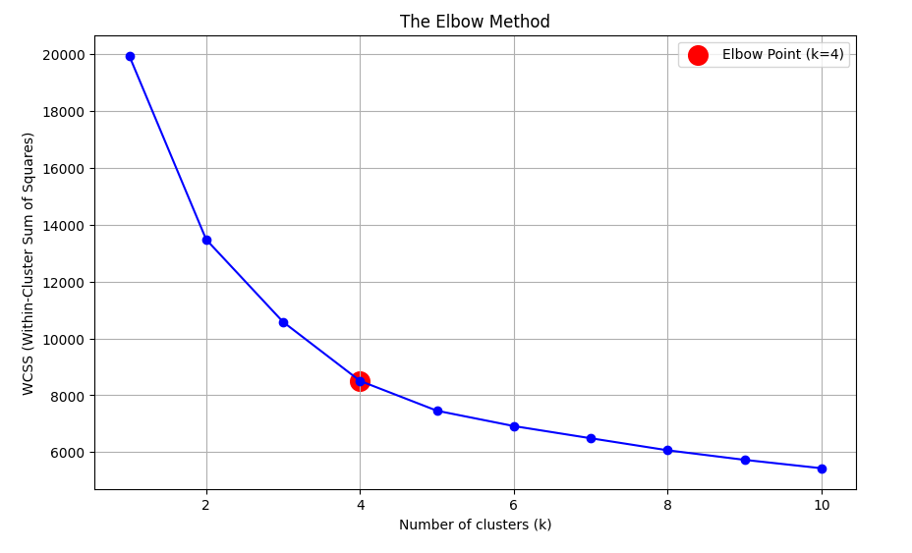
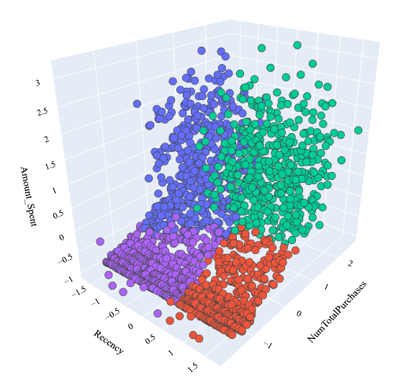
Clustering through K-Means

Slide 7
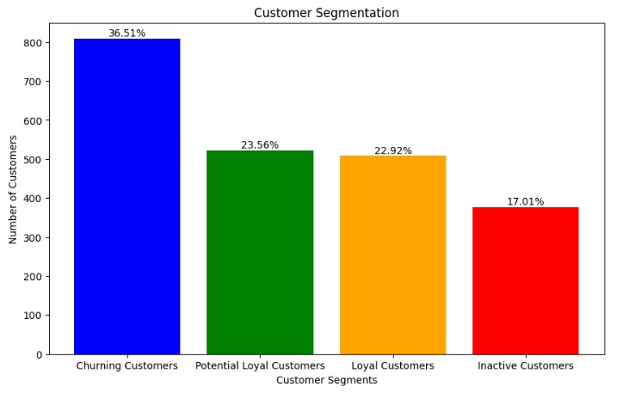
Customer Segmentation
Loyal Customers (High Recency & High Frequency):
Recent purchases frequently
Loyal to brand and engaged with products.
Potential Loyal Customers (Low Recency & High Frequency):
History of frequent purchases.
Make efforts to re-engage them
Churning Customers (High Recency & Low Frequency):
Made recent purchases but less frequently
Risk of churning
Inactive Customers (Low Recency & Low Frequency):
No purchases recently plus low frequency
Targeted campaigns or incentives needed

Slide 8
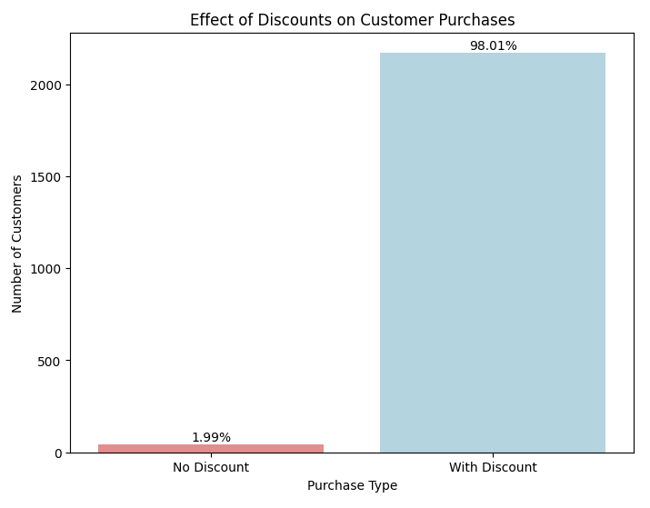
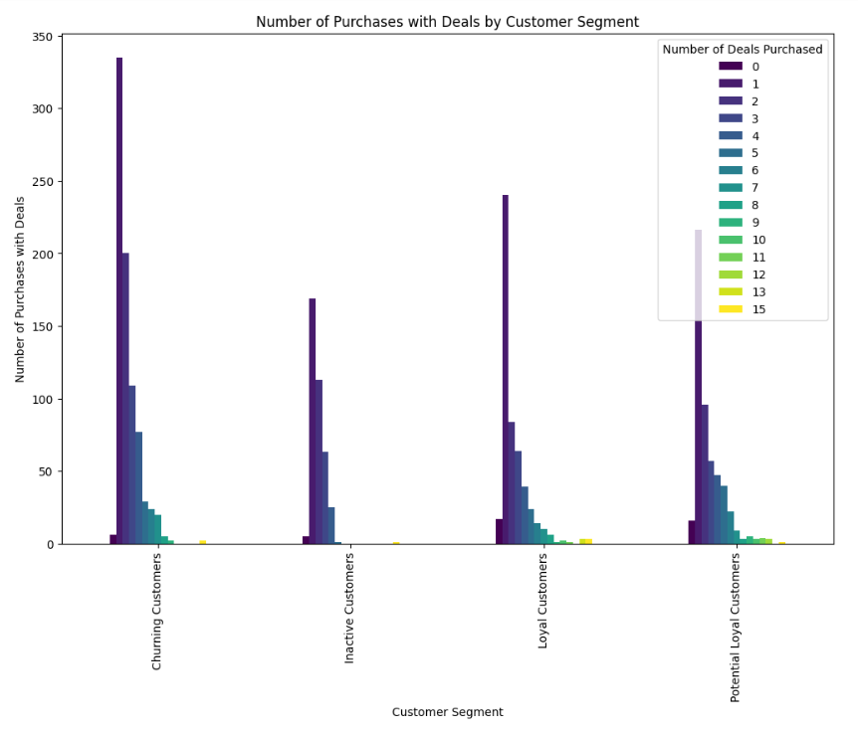
Effect of Discount on Customer Segment

Slide 9
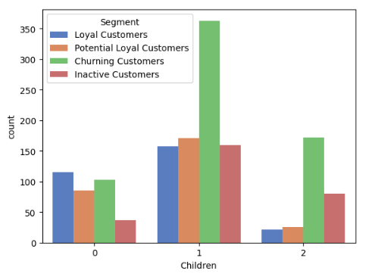
Effect of Children on Customer Segment
Significant proportion of Churning Customers and Inactive Customers have either one or two children.
Considering this pattern, implementing targeted strategies related to children may prove effective in capturing their interest and engagement.

Slide 10
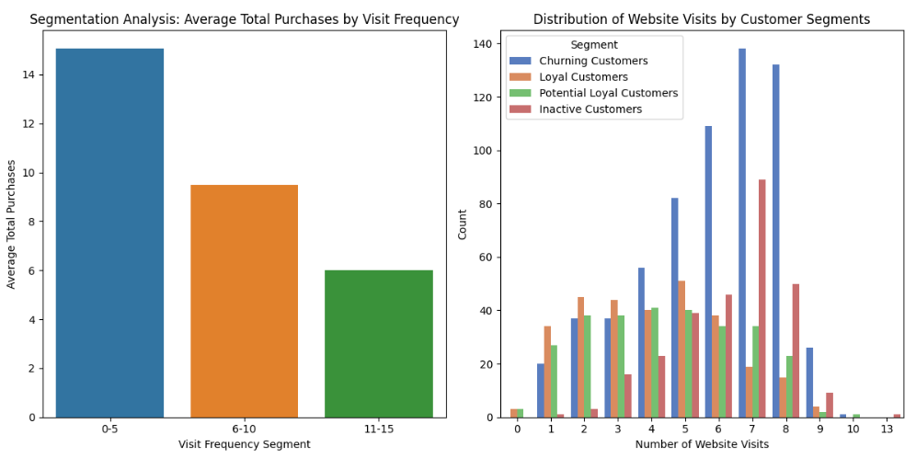
Effect of Website Visits on Customer Segment
As the number of visits to the website increases, the total purchase decreases.
Churning Customers and Inactive Customers exhibit higher visit frequency on the company's website.

Slide 11

Potential Action
Churning Customer Retention Strategies:
Since churning customers are responsive to deals, targeted retention strategies with specific discount offers or promotions might be effective in re-engaging them.
Loyalty Program Optimization:
Loyal and potential loyal customers' consistent usage of deals may highlight opportunities to optimize loyalty programs with tailored promotions.
Inactive Customer Reactivation:
For inactive customers, a different approach may be needed to reactivate their interest, as they are less responsive to deals. Exploring personalized and targeted reactivation campaigns could be beneficial.

Slide 12
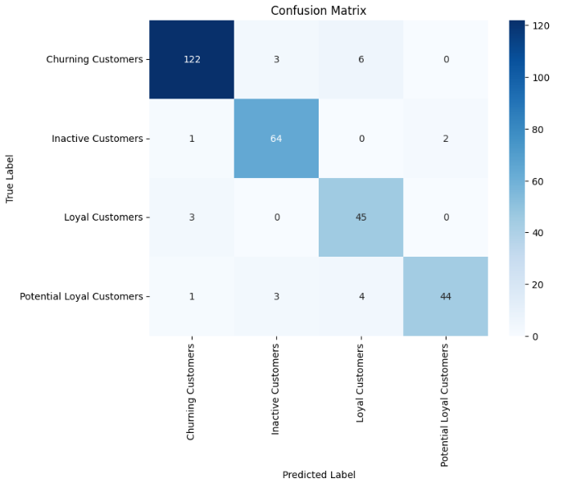

Classification
Simple SVC with OVR Strategy
Accuracy: 92%
SVC with Scaled Features
Accuracy: 96%

Slide 13

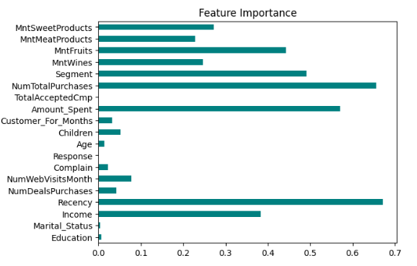
SVC with Feature Importance Accuracy: 99%

Slide 14
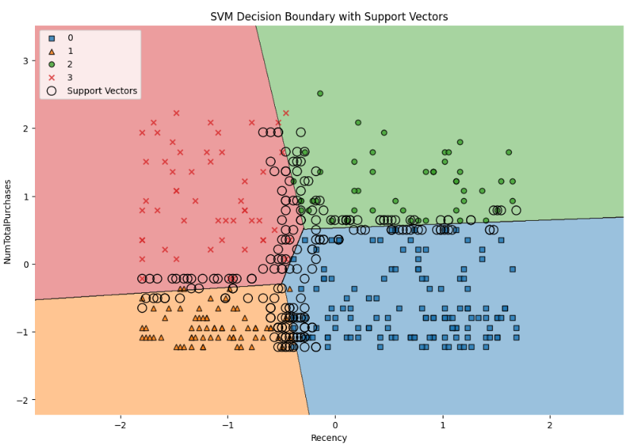
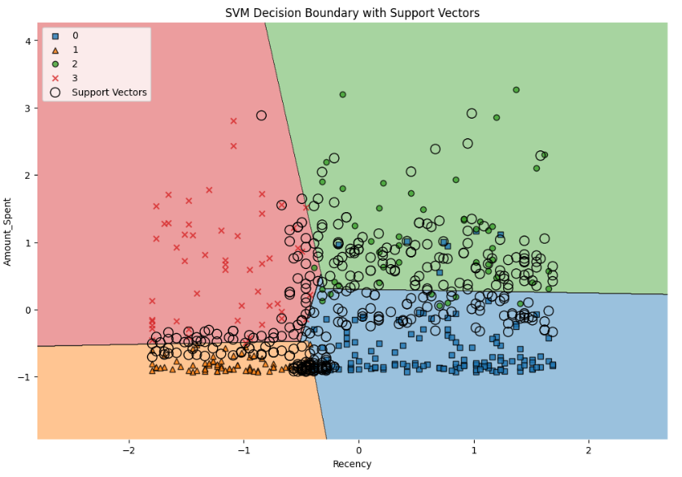
SVM Decision Boundary Plots

Slide 15
Conclusions
Utilized K-means Clustering and RFM Analysis to categorize customers into 4 segments: Loyal, Potential Loyal, Churning, and Inactive.
Identified specific focuses for each segment, such as offering deals to Churning and Inactive Customers, and child-centric promotions.
Suggestion of introducing a loyalty program to attract and retain Loyal and Potential Loyal customers.
Implemented a classification model to categorize new customers and determine targeted engagement strategies.
Improved classification accuracy through feature scaling and the selection of key features.

Slide 16
THANKYOU!!!

